Slide 1


Reasoning :
Fuzzy Logic
Artificial Intelligence Laboratory
Telkom University

Slide 2
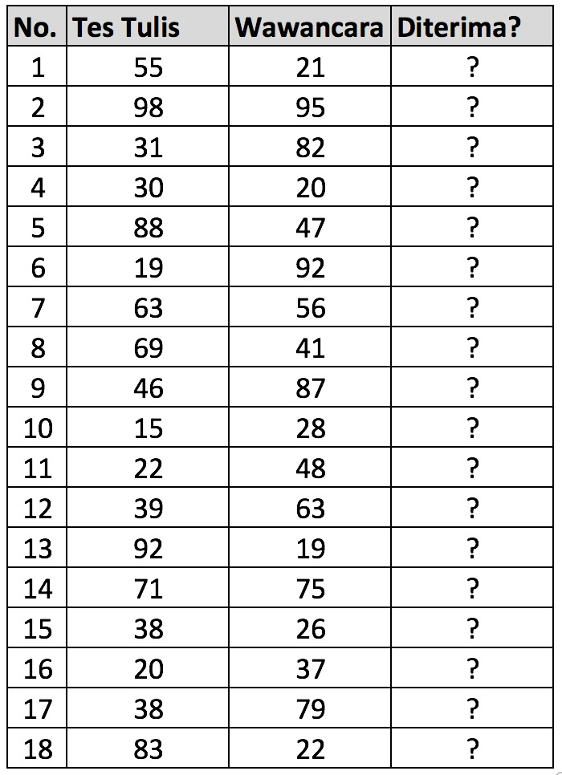
Dataset

Slide 3
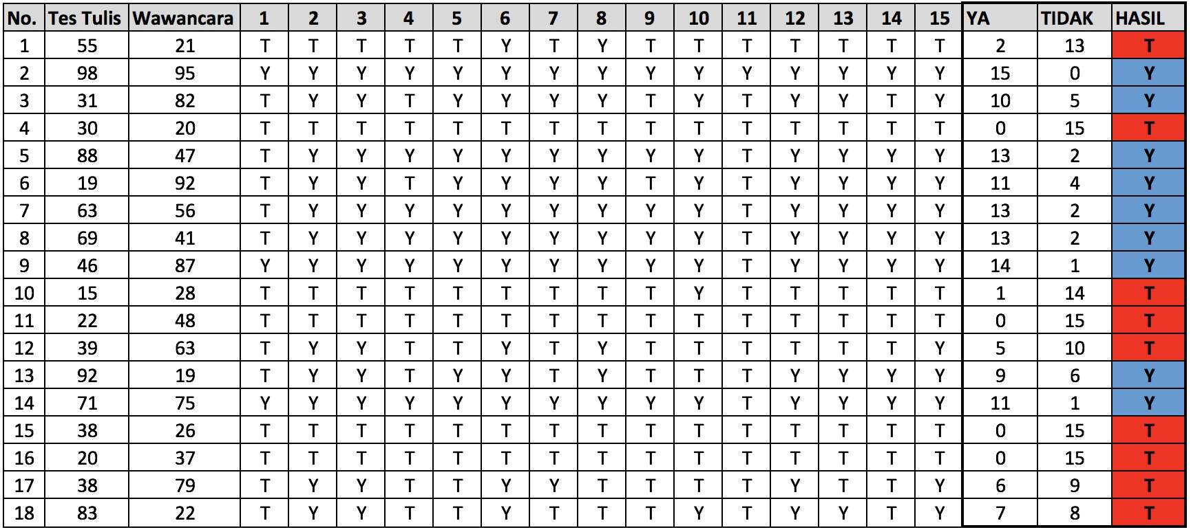
Dataset

Slide 4
Thank You !
Artificial Intelligence Laboratory
Telkom University

